Slide 1
External Interrupts
External interrupts triggered by:
  INT0 or INT1 pins
  Any of the PCINT23:0 pins
INT0 and INT1 are mapped with the pins PD2 and PD3 on ATMega328P
PD2 and PD3 are mapped with digital pins 2 and 3 (GPIO) on the Arduino Uno board
PCINT23:0 are mapped with ports B, C, and D on the Arduino Uno board
Implies any of the I/O pins on the board can be configured to handle interrupts
These interrupts can be used to wake up the processor from sleep modes

Slide 2
External Interrupts
INT0 and INT1 are referred to as ‘External Interrupts’
  Can be triggered by a rising edge, falling edge, logical change, or low level
PCINT23:0 are referred to as ‘Pin Change Interrupts’
External interrupts have a higher priority
External interrupts have their own interrupt vectors
Pin change interrupts share interrupt vectors
  The interrupt handler has to decide which pin the interrupt originated from

Slide 3

EICRA – External Interrupt Control Register A
Contains control bits for interrupt sense control
Bits 7:4 – Reserved bits – always read as 0
Bits 3:2 – ISC11, ISC10 - Interrupt Sense Control 1
Bits 1:0 – ISC01, ISC00 – Interrupt Sense Control 0
ISC1x corresponds to INT1
ISC0x corresponds to INT0

Slide 4
EICRA – External Interrupt Control Register A
External Interrupts activated by the external pin INT1 or INT0 if the SREG I-flag and the corresponding interrupt mask are set.
Level/edge on INT1/INT0 pin which activates interrupts:
ISCx1 | ISCx0 | Description
0 | 0 | Low level of INT1/INT0 generates interrupt request
0 | 1 | Any logical/level change on INT1/INT0 generates interrupt request
1 | 0 | Falling edge of INT1/INT0 generates interrupt request
1 | 1 | Rising edge of INT1/INT0 generates interrupt request

Slide 5
EICRA – External Interrupt Control Register A
Value of the pin is sampled before detecting the edges
If edge or toggle interrupt is selected:
  Pulses longer than 1 clock period will generate an interrupt
  Shorter pulses are not guaranteed to generate an interrupt
If low-level interrupt is selected, to generate interrupt:
  Low level must be held until the completion of currently executing instruction

Slide 6
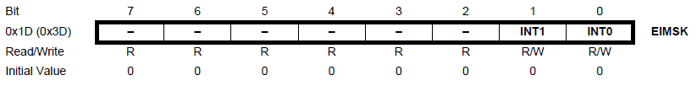
EIMSK – External Interrupt Mask Register
Bits 7:2 – Reserved – always read as 0
Bit 1 – INT1: External Interrupt Request 1 Enable
Bit 0 – INT0: External Interrupt Request 0 Enable

Slide 7
EIMSK – External Interrupt Mask Register
When INT1/INT0 bit is enabled, and I bit (bit 7) of SREG is enabled:
  External pin interrupt is activated
  ISCx1, and ISCx0 pins in EICRA define whether the external interrupt will be activated on:
    Rising edge
    Falling edge
    Logic change
    Low level
Activity on the pin will cause an interrupt even if the pin is configured as an output
Executed from INT1/INT0 interrupt vector

Slide 8
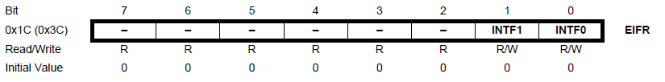
EIFR – External Interrupt Flag Register
Bits 7:2 – Reserved – always read as 0
Bit 1 – INTF1: External Interrupt Flag 1
Bit 0 – INTF0: External Interrupt Flag 0

Slide 9
EIFR – External Interrupt Flag Register
When the INTx pin triggers an interrupt request, INTFx is set
If I bit in SREG and INTx bit in EIMSK are set, MCU will jump to a relevant interrupt vector
INTFx cleared when:
  Interrupt routine is executed
  A logical 1 is written (cancel any falling interrupts)
  Always cleared when INTx is configured as a level interrupt

Slide 10
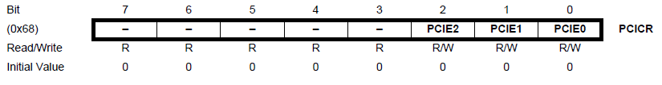
PCICR – Pin Change Interrupt Control Register
Bits 7: 3 – Reserved – always read as 0
Bit 2 – PCIE2 – Pin Change Interrupt Enable 2
Bit 1 – PCIE1 – Pin Change Interrupt Enable 1
Bit 0 – PCIE0 – Pin Change Interrupt Enable 0

Slide 11
PCICR – Pin Change Interrupt Control Register
If PCIEx is enabled and I bit in SREG is enabled, pin change interrupt x is enabled
PCINT 23:16 corresponds to pin change interrupt 2
PCINT 14:8 corresponds to pin change interrupt 1
PCINT 7:0 corresponds to pin change interrupt 0
The pins are enabled individually from PCMSKx register
Executed from PCIx interrupt vector
Any change in these pins will cause an interrupt

Slide 12
PCICR – Pin Change Interrupt Control Register
PCINT 23:16 –
  PD7:PD0 on ATMega328P
  Pins D7:D0 (GPIO) on Arduino Uno board
PCINT 14:8 –
  PC6:PC0 on ATMega328P
  PC5:0 – Pins A5:A0 on Arduino Uno board
  PC6 – Reset pin on Arduino Uno Board
PCINT 7:0 –
  PB7:PB0 on ATMega328P
  PB5:0 – Pins D13:D8 on Arduino Uno board
  PB6 and PB7 are not available externally on the Arduino Uno board

Slide 13
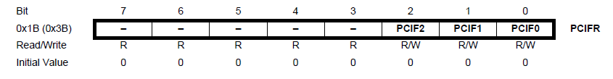
PCIFR – Pin Change Interrupt Flag Register
Bits 7:3 – Reserved – Always read as 0
Bit 2 – PCIF2 – Pin Change Interrupt Flag 2
Bit 1 – PCIF1 – Pin Change Interrupt Flag 1
Bit 0 – PCIF0 – Pin Change Interrupt Flag 0

Slide 14
PCIFR – Pin Change Interrupt Flag Register
Any logic change on PCINT23:0 triggers an interrupt request: PCIFx set
If I bit in SREG and PCIEx on PCICR are set, MCU will go to the corresponding interrupt vector
Flag is cleared when:
  Interrupt routine is executed
  A logical 1 is written

Slide 15
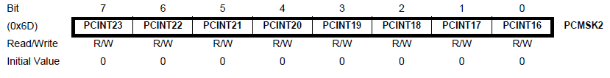
PCMSK2 – Pin Change Mask Register 2
Bits 7:0 – PCINT23:16 – Pin Change Enable Mask 23:16
Each bit selects whether the pin change interrupt is enabled on the corresponding I/O pin
If any bit from PCINT23:16 is set and the PCIE2 bit on PCICR is set, pin change interrupt is enabled on the corresponding I/O pin
If PCINT23:16 is cleared, the pin change interrupt on the corresponding I/O pin is disabled

Slide 16
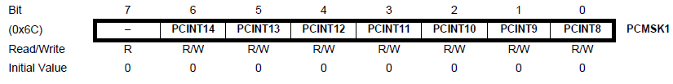
PCMSK1 – Pin Change Mask Register 1
Bit 7 – Reserved – Always read as 0
Bits 6:0 – PCINT14:8 – Pin Change Enable Mask 14:8
Each bit selects whether the pin change interrupt is enabled on the corresponding I/O pin
If any bit from PCINT14:8 is set and the PCIE1 bit on PCICR is set, pin change interrupt is enabled on the corresponding I/O pin
If PCINT14:8 is cleared, the pin change interrupt on the corresponding I/O pin is disabled

Slide 17
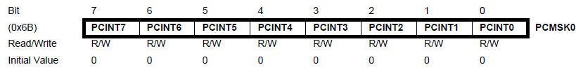
PCMSK0 – Pin Change Mask Register 0
Bits 7:0 – PCINT7:0 – Pin Change Enable Mask 7:0
Each bit selects whether the pin change interrupt is enabled on the corresponding I/O pin
If any bit from PCINT7:0 is set and the PCIE0 bit on PCICR is set, pin change interrupt is enabled on the corresponding I/O pin
If PCINT7:0 is cleared, the pin change interrupt on the corresponding I/O pin is disabled

Slide 18
References
ATMega328 Datasheet
Arduino Uno Datasheet
Chapter 5: Microprocessors, Advanced Industrial Control Technology by Peng Zhang
http://www.ganssle.com/debouncing-pt2.htm
https://mansfield-devine.com/speculatrix/2018/04/debouncing-fun-with-schmitt-triggers-and-capacitors/
https://www.arxterra.com/10-atmega328p-interrupts/
https://www.arxterra.com/11-atmega328p-external-interrupts/
http://www.gammon.com.au/forum/?id=11488

Slide 19

Thanks for attending….
?

